Slide 1

Create Account to List Job
Create a Job Category
Create Account to Find Job
Login to Post / Carf
Job Category: ____________
Recover / Change Password
Category Image: ____________
Create Job Category

Slide 2
Create Account to List Job
Create Account to Find Job
Login to Post / Carf
Recover / Change Password
Electrician
Plumber
Carpenter
Security Guard
Cook
Movers and Packers
Beautician
Medical Support

Slide 3
Create Account to List Job
Create Account to List Jobs
Create Account to Find Job
Login to Post / Carf
Company Name : ____________
Recover / Change Password
Company Registration : ____________
eMail: ____________
Security Guard
Electrician
Plumber
Carpenter
Whatsapp: +65____________
Password: ____________
Reenter Password: ____________
Membership: (x) Member5 ( ) Member20 ( ) Member100
Membership Pricing
Member5 : 5 total listings per year. Each listing will expire after 3 months $250
Member20: 20 total listings per year. Each listing will expire after 3 months $800
Member100: 100 total listings per year. Each listing will expire after 3 months $2,500
Cook
Movers and Packers
Beautician
Medical Support
Next

Slide 4
Create Account to List Job
Create Account to List Job
Create Account to Find Job
Login to Post / Carf
OTP sent to Whatsapp : __ __ __ __
Recover / Change Password
Create
Electrician
Plumber
Carpenter
Security Guard
Cook
Movers and Packers
Beautician
Medical Support

Slide 5
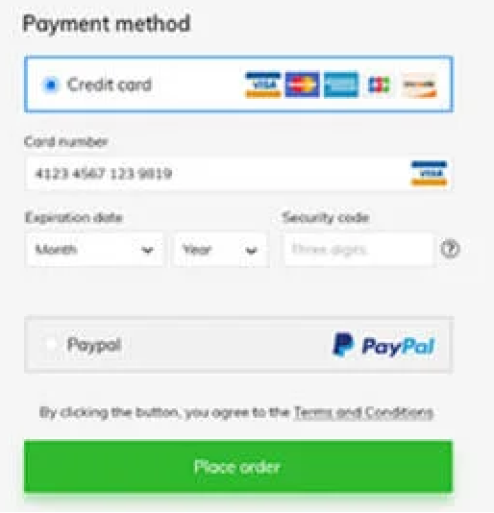
Create Account to List Job
Create Account to List Job
Create Account to Find Job
Login to Post / Carf
Recover / Change Password
Electrician
Plumber
Carpenter
Security Guard
Cook
Movers and Packers
Beautician
Medical Support
Confirm Payment

Slide 6
Create Account to List Job
Create Account to Find Jobs
Create Account to Find Job
Login to Post / Carf
Nick Name : ____________
Recover / Change Password
eMail: ____________
Whatsapp : +60____________
Security Guard
Electrician
Plumber
Carpenter
Password: ____________
Reenter Password: ____________
Membership: RM 50.00 for 1 month
Cook
Movers and Packers
Beautician
Medical Support
Next

Slide 7
Create Account to List Job
Create Account to Find Job
Create Account to Find Job
Login to Post / Carf
OTP sent to Whatsapp : __ __ __ __
Recover / Change Password
Create
Electrician
Plumber
Carpenter
Security Guard
Cook
Movers and Packers
Beautician
Medical Support

Slide 8
Create Account to List Job
Create Account to Find Jobs
Create Account to Find Job
Login to Post / Carf
Recover / Change Password
Electrician
Plumber
Carpenter
Security Guard
Cook
Movers and Packers
Beautician
Medical Support
Confirm Payment

Slide 9
Create Account to List Job
Create Account to Find Job
Login to Post / Cart
Recover / Change Password
User ID
navsrini
Password
********
Login

Slide 10
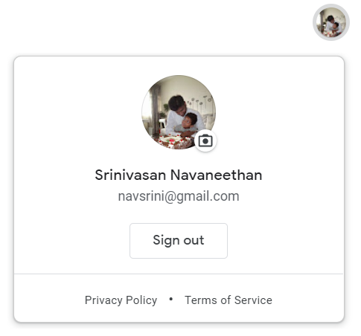

Electrician
Plumber
Carpenter
Security Guard
Cook
Movers and Packers
Beautician
Medical Support

Slide 11
Electrician
J&J Company
Salary Range: $1000 - $1500
Start Date: 01/Sep/22
Temporary
Proproprop Ltd
Salary Range: $1000 - $1500
Start Date: 01/Sep/22
Temporary
J&J Company
Salary Range: $1000 - $1500
Start Date: 01/Sep/22
Permanent

Slide 12
Electrician
Industry: ____________
Security Guard
Electrician
Plumber
Carpenter
Company: ____________
Job Title: ____________
Salary Range: ____________ per month
Cook
Movers and Packers
Beautician
Medical Support
Job Starting Date: ____________
Permanent/Temporary : ( ) Permanent ( X ) Temporary
Apply for this Job
Back

Slide 13
Add a new Job Listing

Slide 14
Click on the Job to Edit/Delete
Electrician
Cook
Add a new Job Listing

Slide 15
Electrician
Plumber
Carpenter
Security Guard
Cook
Movers and Packers
Beautician
Medical Support
Request to add a new Job Category

Slide 16
Create Account to List Job
Create a Job Listing
Create Account to Find Job
Login to Post / Carf
Industry: ____________
Recover / Change Password
Company: ____________
Job Title: ____________
Security Guard
Electrician
Plumber
Carpenter
Salary Range: ____________ per month
Job Starting Date: ____________
Permanent/Temporary : ( ) Permanent ( X ) Temporary
Cook
Movers and Packers
Beautician
Medical Support
Create Job

Slide 17
Create Account to List Job
Create a Job Category
Create Account to Find Job
Login to Post / Carf
Job Category: ____________
Recover / Change Password
Submit Job Category Request

